Slide 1

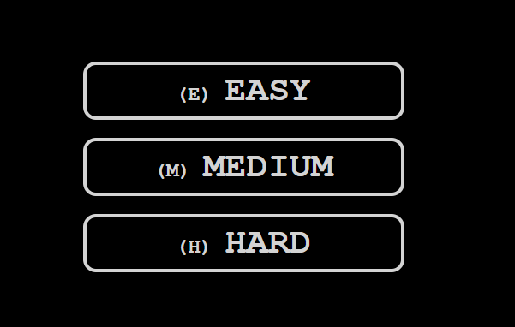
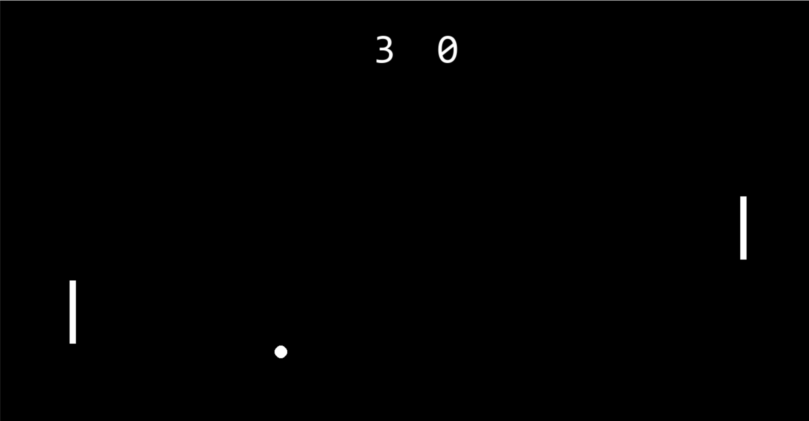
Ping pong game
This GitHub repository hosts a simple yet engaging interpretation of a classic ping pong game. The ball is meant to be hit past the other player to get points. Designed as a fun and practical way to practice game development concepts, it provides a solid foundation for learning about real-time interactivity, game logic, and UI design.
This is an image of my idea for what I would like to include in my main menu screen. This will give users the chance to increase the difficulty of their opponent.
Project Team Member(s): Landon Ramaeckers
I currently am this far in the process of developing the game, but there is still more features I want to include. As of now it is fully functional though.
https://github.com/ksu-is/Ping-Pong-Game

